Slide 1
How To Download The Church App & Sign Up To A Rota

Slide 2
Android devices – tap Google Chrome App
Type in the web address:
www.euxtonparishchurch.org/hubb
Click the Green install the App
Tap the Euxton Parish Church App
to open and login / register

Slide 3
Iphones/Ipads – go to Safari web browser
Type in the web address:
www.euxtonparishchurch.org/hubb
Click the Green install the App
Tap the Share button then add to Home Screen
Tap the Euxton Parish Church app
to open and login / register

Slide 4
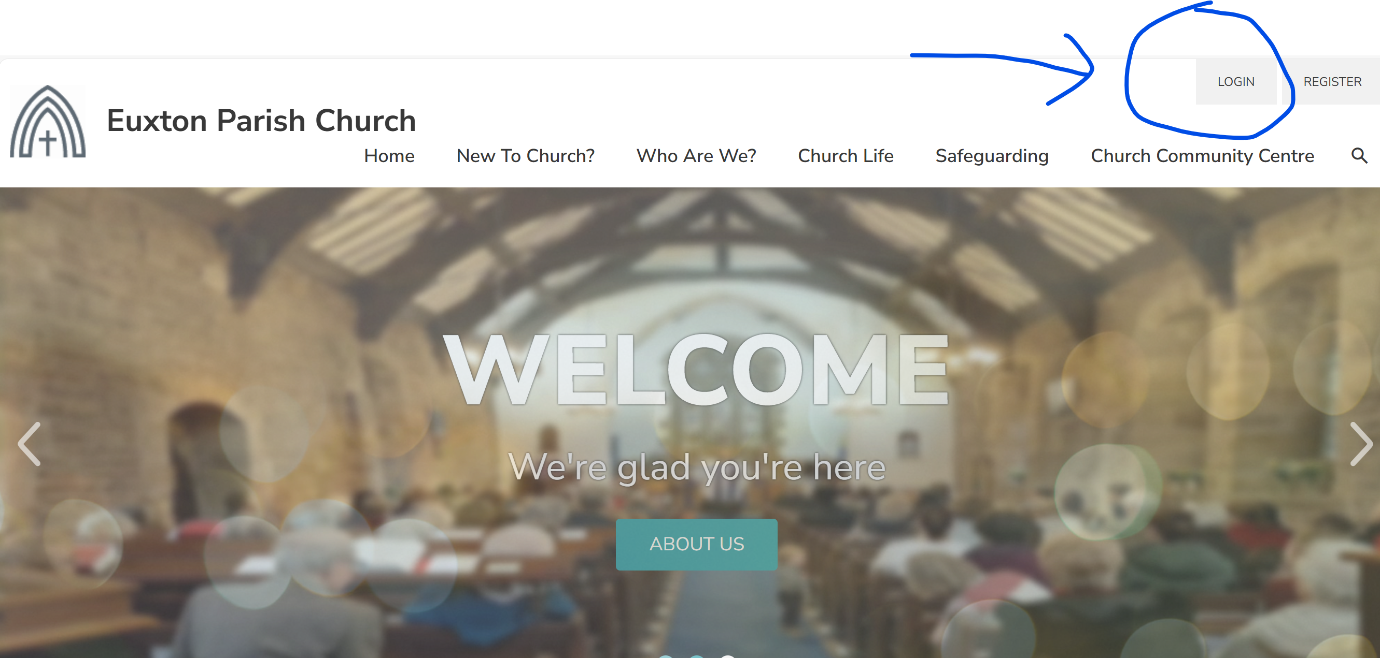
Step 1) Log In - via the EPC website or app – forgotten your password? email Gail: admin@euxtonparishchurch.org

Slide 6
How To Sign Up To A Church Rota

Slide 7
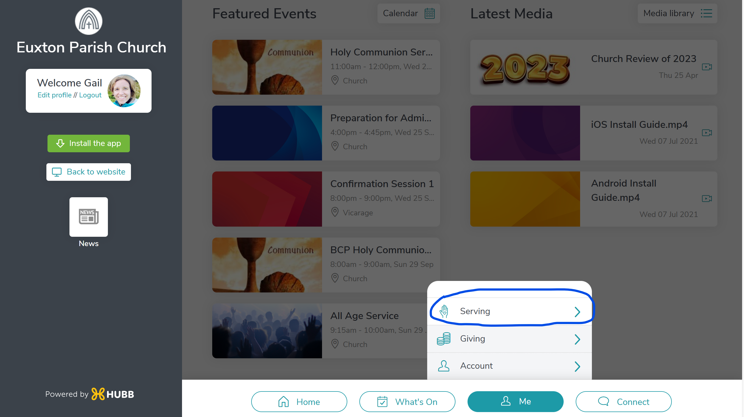
Step 2) Click on the ‘Me’ icon and select ‘Serving’

Slide 8
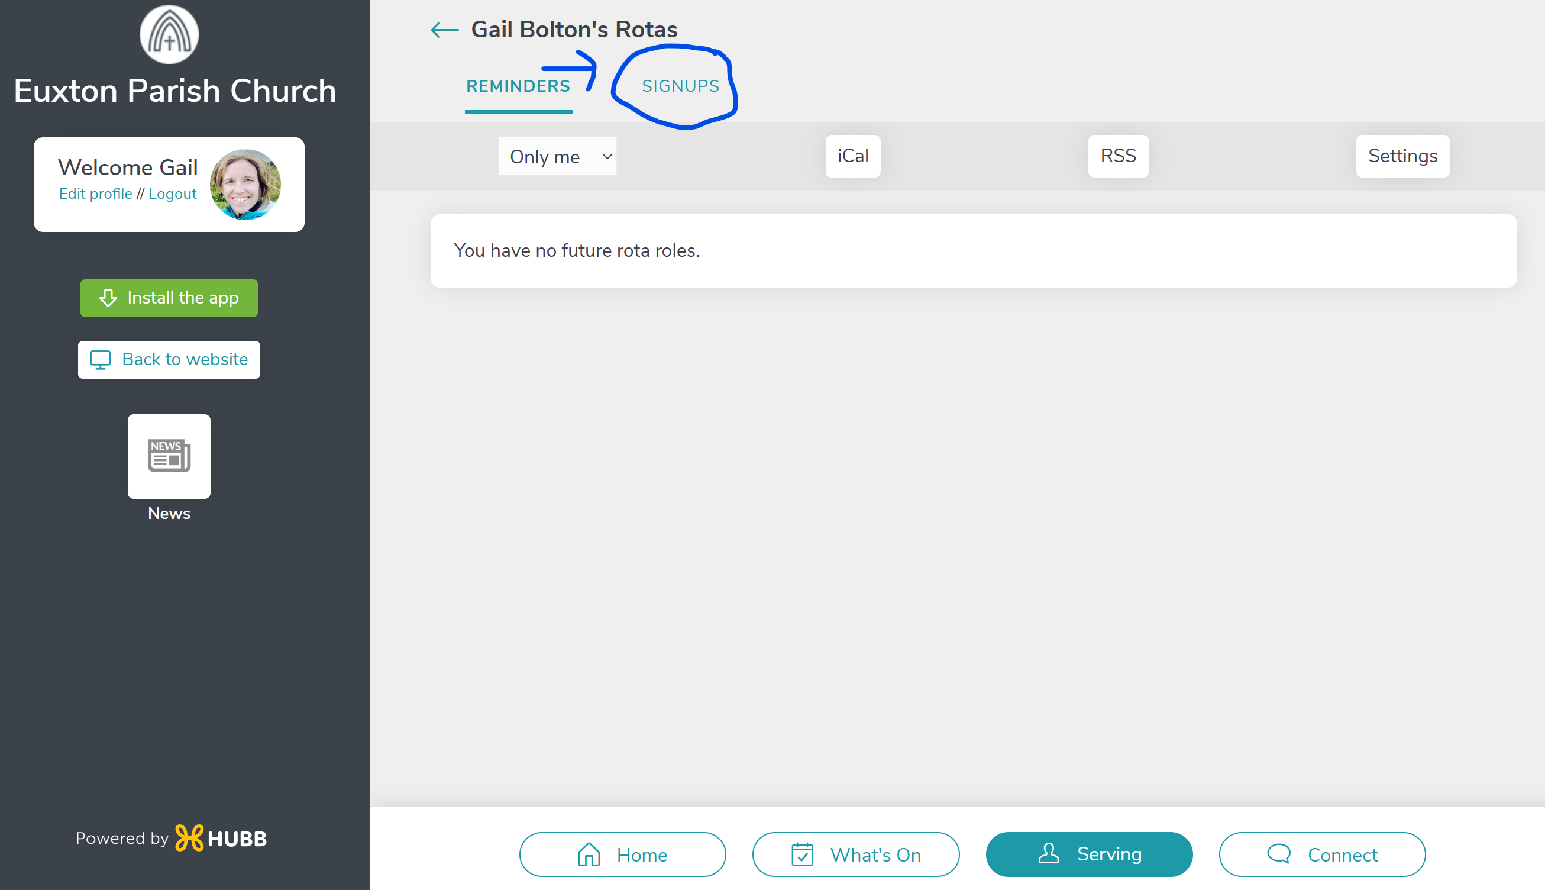
Step 3) Click ‘Signups’ at the top

Slide 9
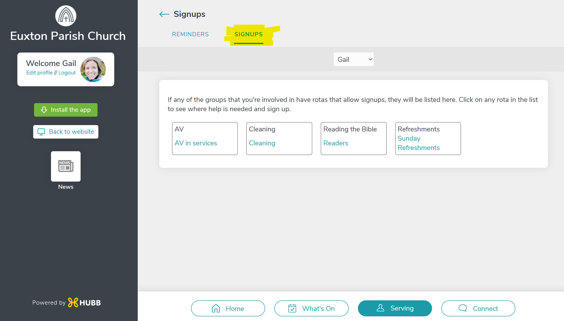
Step 4) Select your Group to view the rota

Slide 10
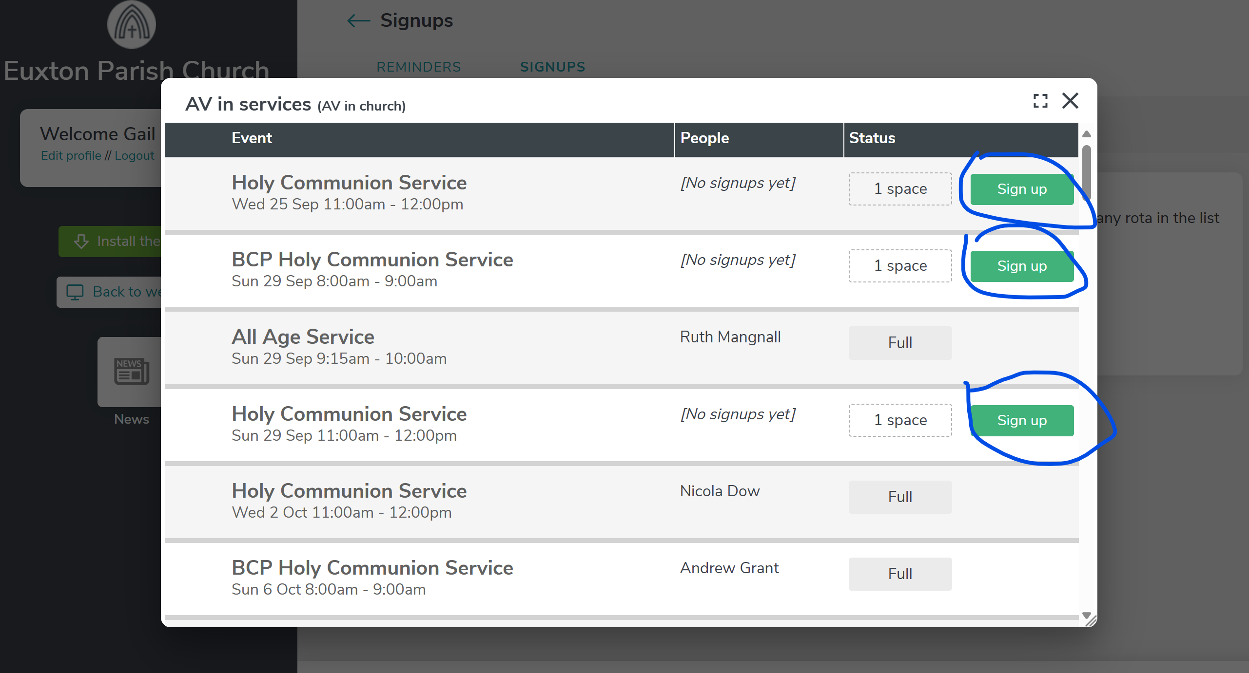
Step 5) View the rota and click ‘Sign Up’ to be added

Slide 11
Rota Reminders
You will receive a Reminder email 3 days before your Serving date.
Thanks for supporting our Church!

